Slide 1
MyBusID: Authentication and Verification
Discovery
Nov- Jan 2017

Slide 2
Background to research
My Business ID was initially intended to be a Scottish Government single sign on tool where basic data would be shared across HIE, SDS, SE, BG etc However at present, it’s only SE that uses MyBusinessID as an authorisation and registration tool to access the SE MY Account area and to sign up for newsletters, and BG for users registering for events.
At SE we’re trying to determine whether we need to offer a tool that enables users to also access other public sector business-related websites using one log in and password and via a main account area. In tandem at SE, we also need to know what level of verification will be required for different services offered by SE and what verification tools we need to put in place.

Slide 3
What is Authorisation, Verification & Authentication?
Authorisation:
Act of confirming that a registered user is entitled to access a service prior to permitting that access.
Verification:
Way to prove your identify when using government services by using tools such as Experian, Post Office, Royal Mail.
Authentication:
Act of ensuring or checking that a user of a service or system is the owner of the identity they claim to be.

Slide 4
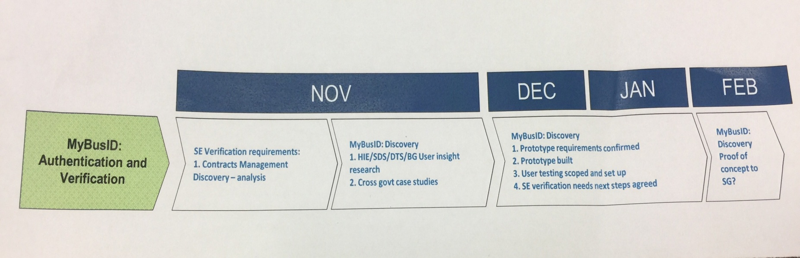
Anticipated Timeline
High level view of the Discovery phase: 1 Nov ‘16 to end of Feb ‘17.

Slide 5
Discovery phase
The purpose of the Discovery phase is to understand:
Who are our users – current and future
Where are they? UK and/or abroad?
Understand users’ current experience /perceptions of using single sign on and registration tools?
Establish if there is a user need for a common single sign on/registration tool?
Establish Scottish Enterprise’s verification requirements
Understand how any potential solution fits with the strategic direction of Scottish Government
Find use cases

Slide 6
Discovery Approach
The research is being conducted in three phases:
Phase 1
Face to face depth sessions are planned for Sep/Oct ‘16 to map out the contract management process to identity where, why and how verification takes place. This process has highlighted that further research is needed with staff from another part of the business involved in the verification process. The deadline for completion for this phase is 31 Dec ’16
Cross government engagement with HIE, BG, SDS and other government departments to understand who else is working on the same topic and gather use cases
Phase 2
Scope out research (aims and objectives)
Write discussion guide
Conduct fieldwork (face to face depth interviews) with Business Gateway, Scottish Development International and Scottish Enterprise customers
Phase 3
Analysis and report to (pp slide deck) to be presented to Kirstie Lamont, Project Lead. Target completion date for interim report end Nov ‘16 and final report by end Dec ‘16.

Slide 7
Emerging findings – cross governments
SE have identified several organisations who are looking at the same issue and/or have an interest in the topic.
To ensure SE fully understands the current landscape and maximises the opportunity for cross learning Kirstie Lamont has set up and is leading 2 cross government network groups who are actively share learning in this are. These are:
Group 1: Scottish wide – HIE, BG and SDS
Group 2: Nationwide – HMRC, ONS, Innovate UK, Office of the Public Guardian, Scottish Government, Government Gateway (add rest)

Slide 8
HMRC
The driver for a verification process at HMRC is fraud reduction. No discovery took place to understand user needs as the business need was evident.
They are designing a 2-step verification process (2SV) for business customers. The original focus was on small businesses (Ltd companies and sole traders) but they are now looking at larger businesses including agents
12 design sprints have taken place since May ’16. These included starting with telephone 2SV (in addition to Govt Gateway). They have tested personal or business verification and the use of commercial software apps (like Google Authenticator). In addition, they explored Verify and how it could link to an HMRC specific identity check for use in Tax Credits

Slide 9
HMRC example
Challenges
Sole traders have multiple people filling in tax forms and is not necessarily one named person e.g. Could be one person dealing with the end of year accounts (accountant) who then pass on to the company director.
So in the two step process the accountant might have the code but the company director can’t get in to the HMRC account unless they share the code.
User journey: single account steps
Single account with secret key
Admin can log in & set up additional security
(where users share same log in)
Sign up to a two step verification
Admin sets up their own phone + sets up additional users
User downloads authenticator app
Types in secret key which generates six digit code
Enters six digit code to access the account before it expires
Administrator appointed and sharing options: add other users, manage users, create individual Govt Gateway passes and shares secret key and QR code. Admin can also set permissions on the account for assistants. Number generated is the same as others and then they can access the account.
Contact: Michael Burnett, HMRC
michael.burnett@digital.hmrc.gov.uk

Slide 10
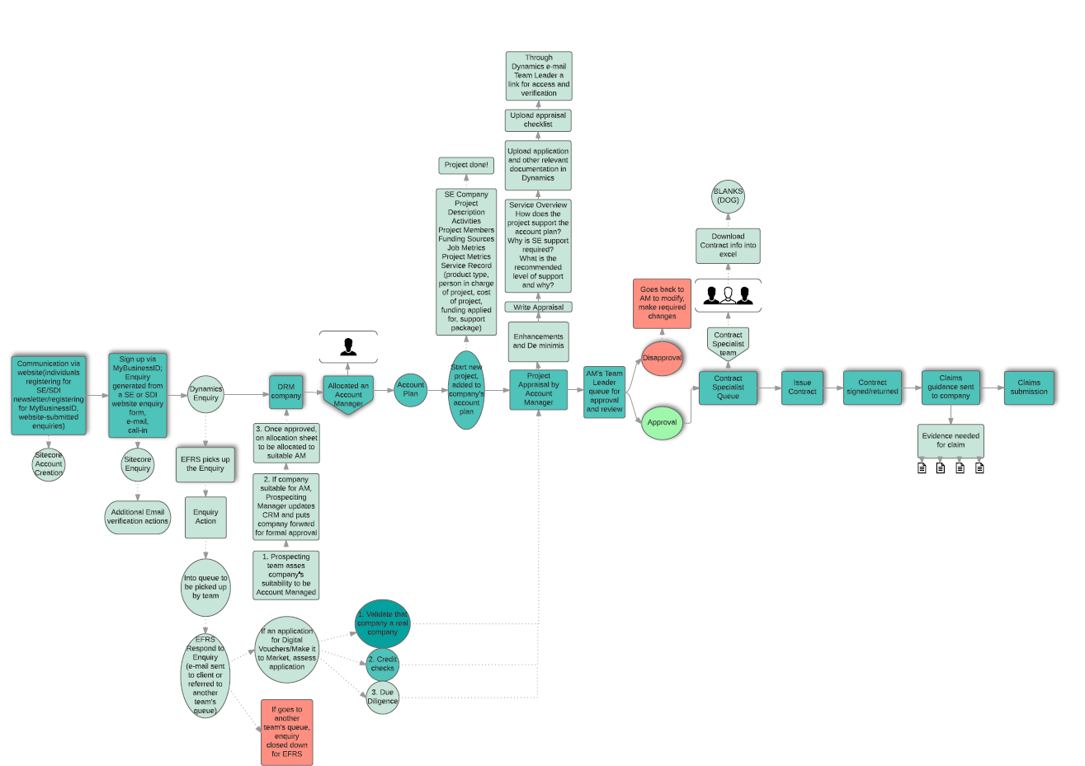
Key findings of verification;
During the account management relationship information/pieces of verification happen naturally through conversation etc – what does that look like/what happens?
Identified that there is some level of that takes place earlier in the journey.

Slide 11
Phase 2
Focused on Prospecting Team processes and where verification takes place. Discovered that customers come in via 3 routes:
Business Gateway (NRM)
Referral for Account Management (DRM)
All others; can be chance meetings at events, conversations with specialists etc.

Slide 12
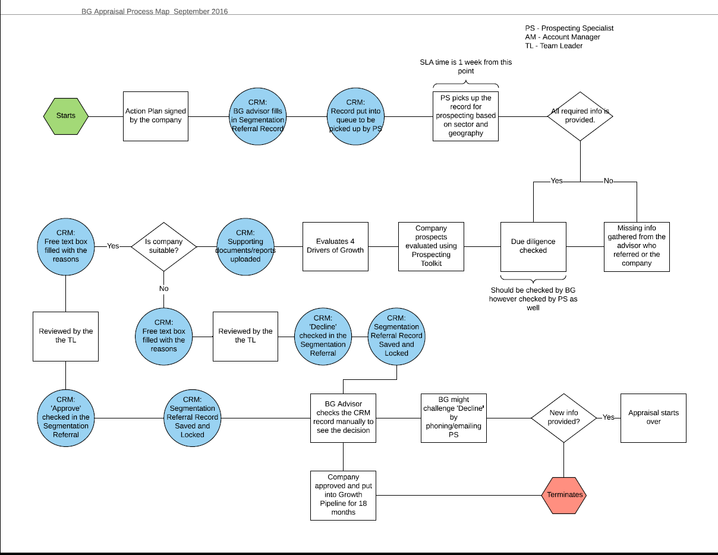
Business Gateway (NRM) Process Map
Main findings;
There is an expectation that Business Gateway will have carried out verification/due diligence.

Slide 13
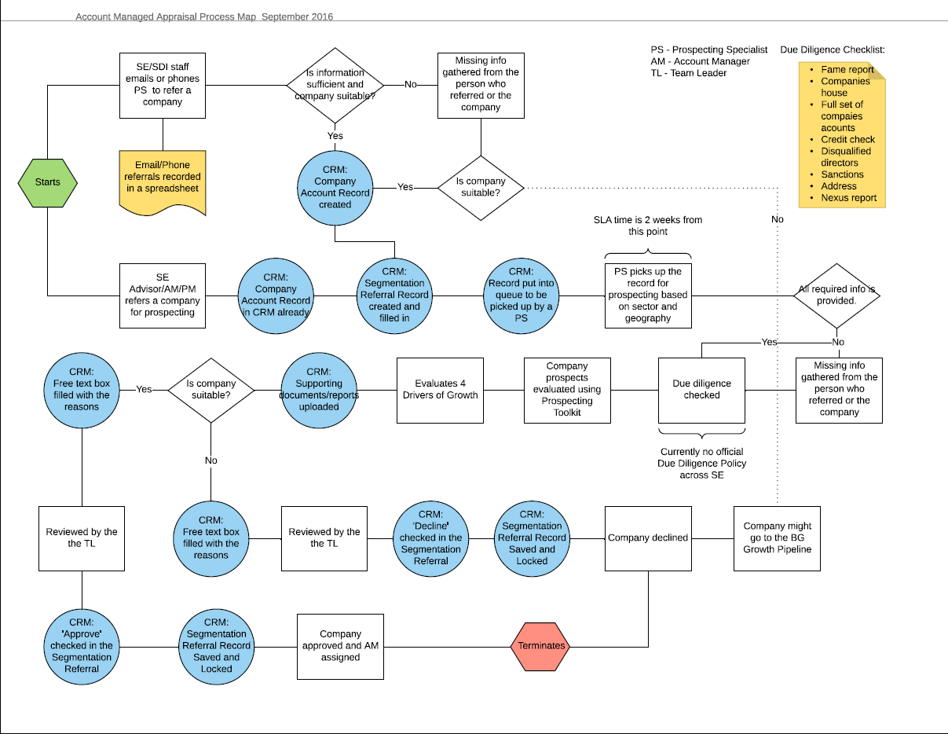
Referral for Account Management (DRM) Process Map
Main findings;
Prospecting team are responsible for carrying out due diligence/verification of business including checks such as:
Fame Report
Credit Check
Companies House Checks
Full set of company accounts
Disqualified directors list
Sanctions
Address Flags
Nexus Report

Slide 14
All other sources
Can be chance meetings at events, conversations with specialists etc, can come through via segmentation referral, email or telephone call.
Dependant on outcome as what, if any verification is carried out, would generally fall into either of the above or be signposted to another relevant agency.

Slide 15
Customer Research
Phase 3
Cross government crowd sourcing to understand what’s out there already, what we can learn from it and identify use cases.
Pulled together cross government group (HIE, Scottish Government, SDS, SLC). With a view to taking a joint approach to understanding the problem and potential solutions.
Also started exploratory fieldwork comprising of face to face interviews with This is Milk and MadeBrave. The purpose of this is to shape a bigger piece of discovery research which we will be commissioned externally. This will provide a comprehensive inline with research already underway with HIE.

Slide 16
MadeBrave/This is Milk photos

Slide 17
Gaps
EFRS – Digital Vouchers – know credit check and due diligence carried out but what does this involve?
Unclear what level (if any) of verification or due diligence is carried out by BG.
Unclear if any SLA in place to ensure verification/due diligence is carried out by BG.
No official SE policy on due diligence/verification – what is the unofficial line?
Does the customer know what checks are taking place?
Has the customer given permission?
Are there different levels of verification depending on level of grant/support involved?
Where are these documented?
What, if any verification is taking place at the appraisal stage of an application.
Is verification mentioned in the grant contracts?
Contract management process – Companies house check – why does this take place, what is the purpose (is it to check address or something else.)

